Slide 1

Ghaziabad-U.P.-201009
IMS ENGINEERING COLLEGE
COLLEGE CODE-143
MINI PROJECT
ON
FLAPPY BIRD
SUBMITTED TO DEPARTEMENT OF COMPUTER SCIENCE
MENTOR : Ms. Anamika mittal(assistant prof. ,cse Dept..)
HOD: DR.Sonali Mathur
SUBMITTED BY:
Saurabh suman jha (2001430100194)
Tushar Yadav (2001430100227)
Suraj Raj (2001430100219)
Satyam kumar (2001430100193)
Shiva sharma (2001430100200)

Slide 2
CONTENTS
AKNOWLEDGEMENT
COURSE OVERVIEW
MOTIVATION
ABOUT THE PROJECT
BASIC FUNCTION USED
MODULE USED
SOURCE CODE
OUTPUT
CERTIFICATE
THANK YOU

Slide 3
Acknowledgement
We sincerely wish to thank Ms. Anamika Mittal for guiding and providing all the necessary resources and facilities for our project without which it would not have been possible to complete project.
We would also like to thank our friends who have helped us with their valuable suggestions and guidance that has been helpful in various phases of the completion of the project.

Slide 4
COUSRE OVERVIEW
Built-in Functions
Numbers
Strings
Lists
Dictionaries
Tuples
Sets
Conditional statements in python
Loops in python
Functions

Slide 5
MOTIVATION
We all play digital games now a days, but most of us play games just for Fun, So we have made a game named flappy bird which is digital as well as it helps the person who is playing the game to improve his/her reaction time .This game makes person use his /her logical ability and speed .This game challenges a person to use his/her speed to let the bird not touch the poll as well as playing this game is fun too. So, everybody can play this game which will sharpen their rection time and will gave them a brilliant playing experience

Slide 6
ABOUT THE PROJECT
The projects features a Flappy Bird game against a simple Python library
In this game there is a bird and various poll having random size and the game is to be played in such a way so, that the bird does not touch the poll
It is not a multiplayer game. Instead it is a single player game in which only one player will play and score as high as he/she can .
The game is only for phones, smart phones not for windows user

Slide 7
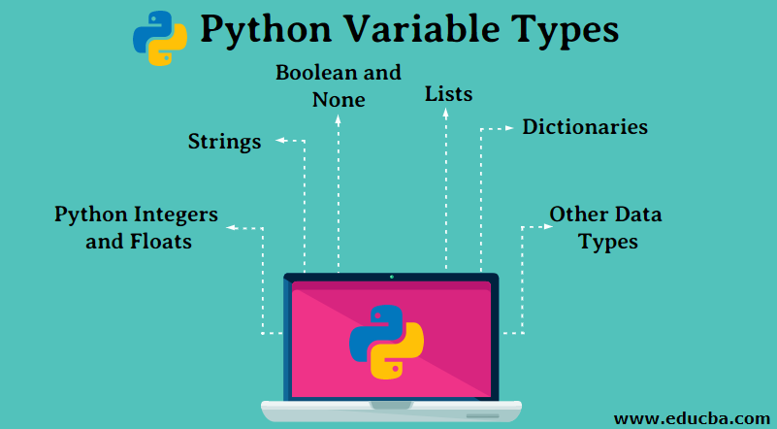

Slide 8
PYTHON INTEGER AND FLOAT
Integers –
        This value is represented by int class.
        It contains positive or negative whole numbers (without fraction or decimal).
Float –
        This value is represented by float class.
        It is a real number with floating point representation.
String-- In Python, Strings are arrays of bytes representing Unicode characters.
A string is a collection of one or more characters put in a single quote,
double-quote or triple quote

Slide 9
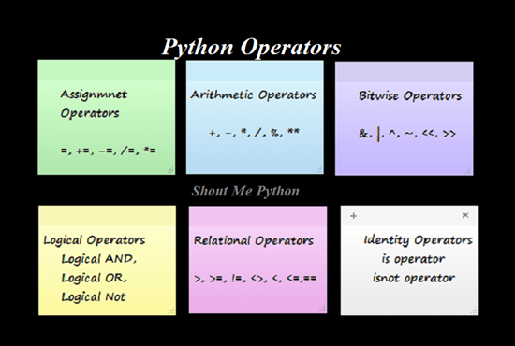
OPERATORS

Slide 10
LISTS:
Lists are just like the arrays, declared in other languages which is a ordered collection of data. It is very flexible as the items in a list do not need to be of the same type.
            CREATING A LIST:
            thislist = ["apple", "banana", "cherry"]
                print(thislist)
              OUTPUT:
              ["apple", "banana", "cherry"]
[
['apple', 'banana', 'cherry']

Slide 11
DICTIONARY
Dictionaries are used to store data values in key:value pairs.
SYNTAX:
  thisdict = {
  "brand": "Ford",
  "model": "Mustang",
  "year": 1964
  }

Slide 12
TUPLES:
A tuple is a collection which is ordered and unchangeable.
Tuples are used to store multiple items in a single variable
EXAMPLE:
  mytuple = ("apple", "banana", "cherry")

Slide 13
CONDITIONAL STATEMENTS
An "if statement" is written by using the if keyword.
The elif keyword is pythons way of saying "if the previous conditions were not true, then try this condition".
The else keyword catches anything which isn't caught by the preceding conditions
EXAMPLE:
  a = 200
  b = 33
  if b > a:
  print("b is greater than a")
  elif a == b:
  print("a and b are equal")
  else:
  print("a is greater than b")

Slide 14
PYTHON LOOPS
Python has two primitive loop commands:
while loops
for loops
WHILE LOOPS
EXAMPLE:
i = 1
while i < 6:
print(i)
i += 1
SYNTAX:
while(condition):
set of statements
FOR LOOPS
EXAMPLE:
fruits = ["apple", "banana", "cherry"]
for x in fruits:
print(x)

Slide 15
FUNCTIONS
A function is a block of code which only runs when it is called.
You can pass data, known as parameters, into a function.
A function can return data as a result.
SYNTAX:
  def myfunc(argument):
  “block of code”
  return “data”

Slide 16
PYTHON MODULES
>RANDOM()--Python Random module is an in-built module of Python which is used to generate random numbers.
SYNTEX: import random
>SYS()--Python sys module contains an in-built function to exit the program and come out of the execution process
SYNTEX import sys sys.exit()

Slide 17
Another or main modules of this project
Modules of Pygame libaray
Pygame is a cross-platform set of Python modules designed for writing video games. It includes computer graphics and sound libraries designed to be used with the Python programming language.
>> import pygame from pygame.locals import *
It imports all the available pygame modules into the pygame package.
The second line is optional, and puts a limited set of constants and functions into the global namespace of your script.

Slide 18
>>pygame.init()
. Before you can do much with pygame, you will need
to initialize it.
. This will attempt to initialize all the pygame modules
for you. Not all pygame modules need to be
initialized, but this will automatically initialize the ones
that do.
>> pygame.time.Clock()
. create an object to help track time
Clock()-> Clock
>> pygame.display.set_caption()
. Set the current window caption
>> pygame.image.load()
. load new image from a file (or file-like object)

Slide 19
pygame.transform.rotate | rotate an image
pygame.mixer.Sound | Create a new Sound object from a file or buffer object
pygame.Surface.convert_alpha | change the pixel format of an image including per pixel alphas
pygame.event.get | get events from the queue

Slide 20
pygame.quit | uninitialize all pygame modules
pygame.Surface.blit | draw one image onto another
pygame.display.update | Update portions of the screen for software displays
pygame.time.get_ticks | get the time in milliseconds

Slide 21
PROJECT MADE ON
FLAPPY BIRD
Using
PYTHON

Slide 22
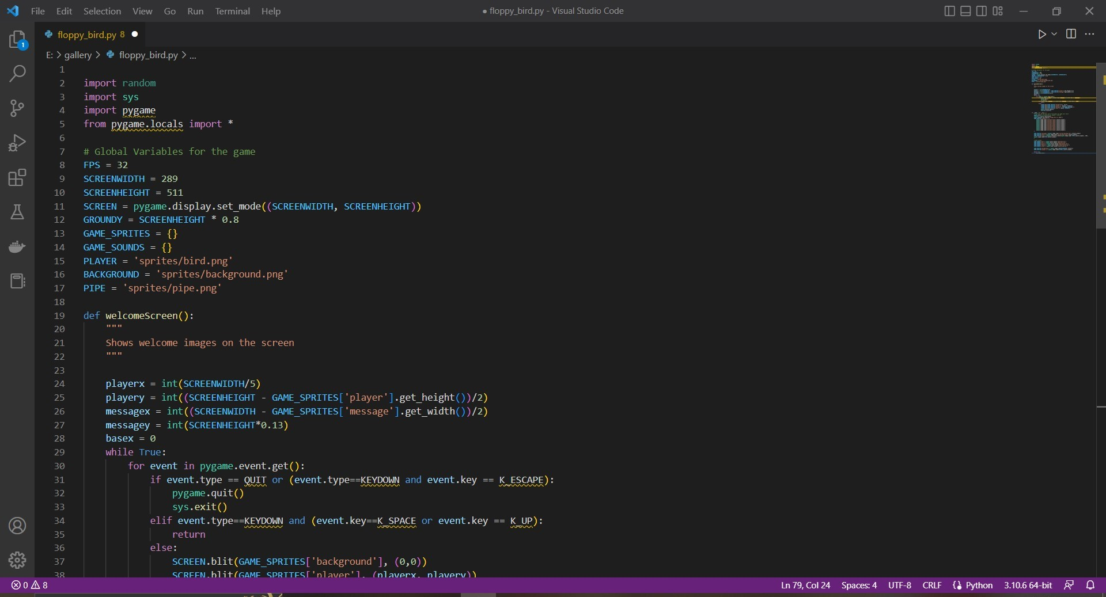
SOURCE CODE

Slide 23
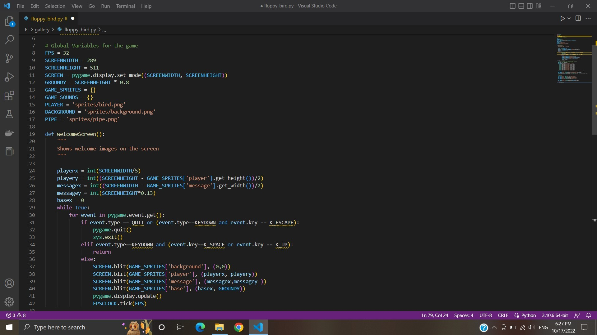

Slide 24
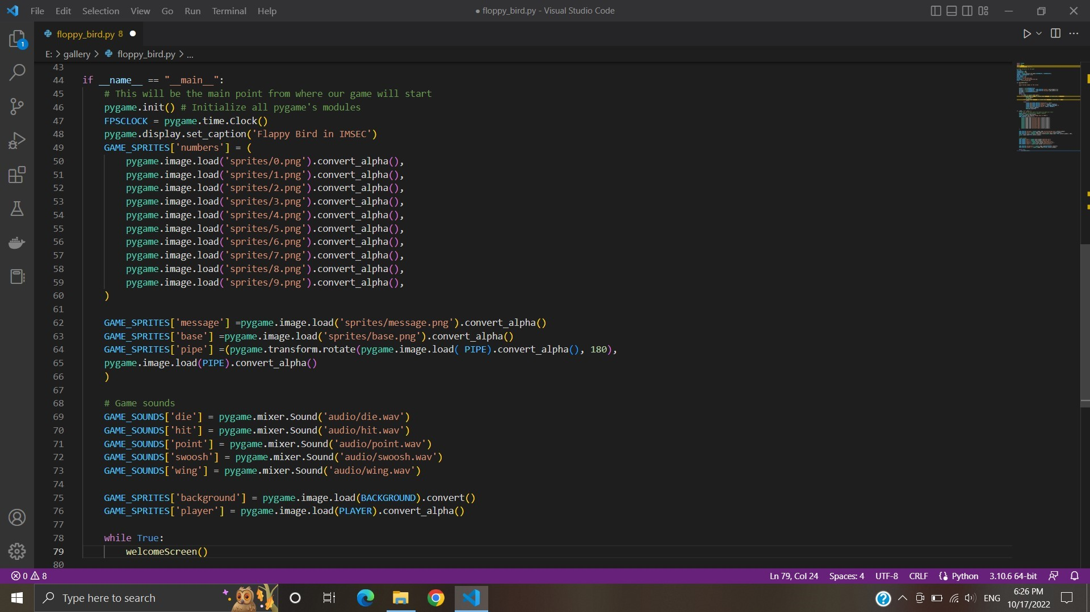

Slide 25
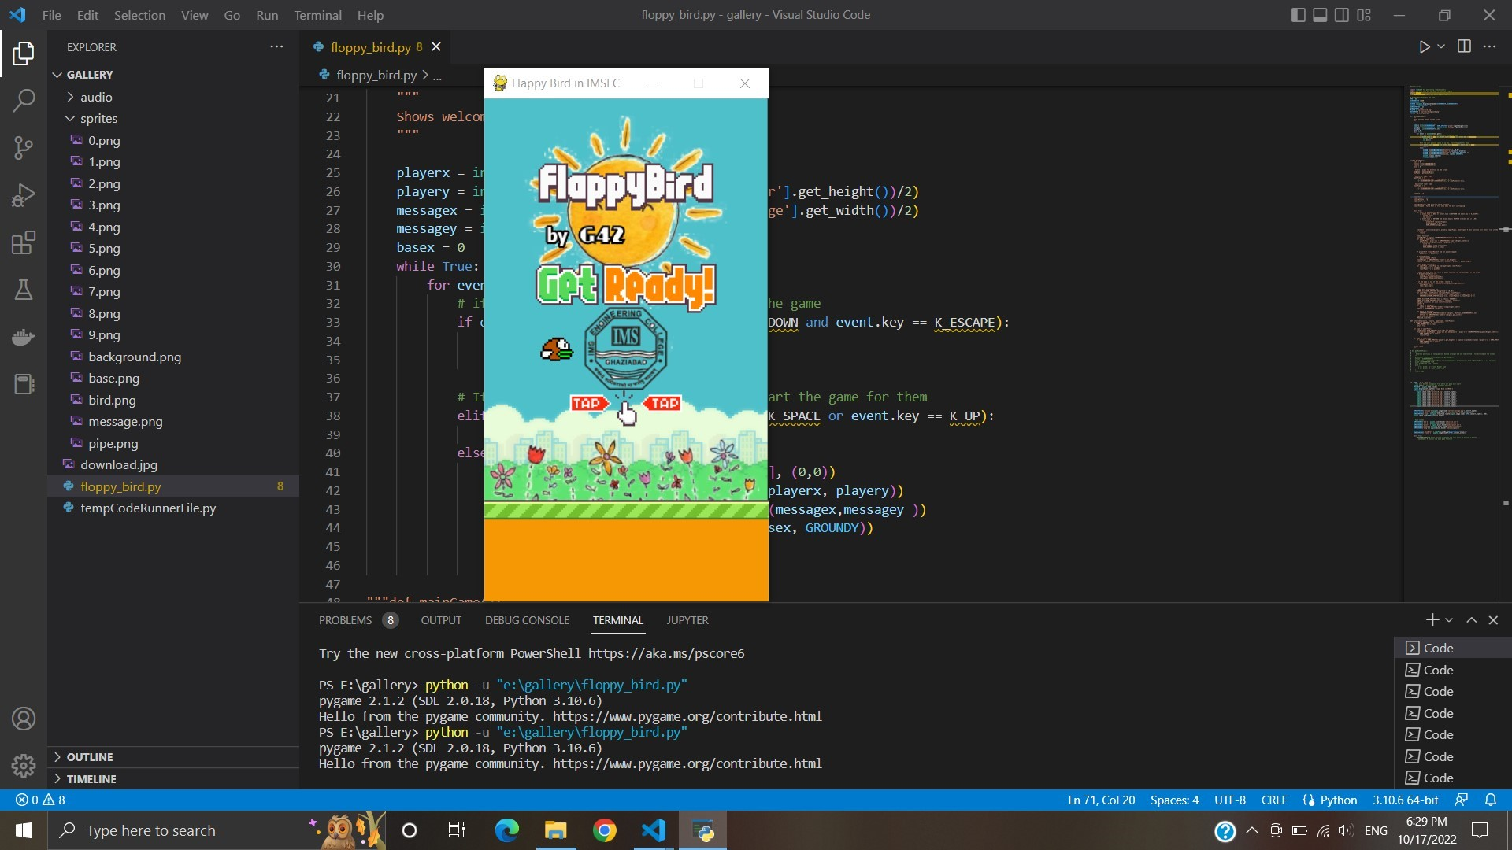
Output

Slide 26
CERTIFICATE
WE CERTIFY THAT WORK EMBODIED IN THE PRESENT IS THE
STUDENTS (DETAILS ARE GIVEN BELOW) OWN WORK AND
THAT IT WAS CARRIED OUT UNDER OUR SUPERVISION
SESSION 2022-23
SIGNATURE OF TEACHER

Slide 27
THANK YOU

